Slide 1
CML’s 95th Annual Conference June 20 – 23, 2017 Breckenridge

Slide 2
CML Annual Meeting June 21, 2016
Drones: A Legal Update
John Putnam, Managing Partner
Kaplan Kirsch & Rockwell, LLP

Slide 3
Denver Donut Delivery

Slide 4
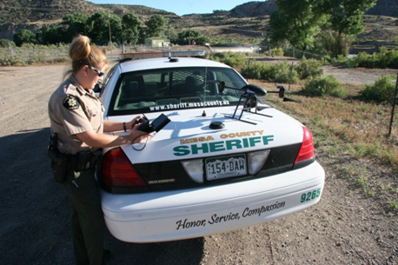
Municipal Interest in UAS
City use
EMS
Property management
Resource management
Code enforcement
Utilities
Regulation of drone use
Safety
Privacy
Protection of critical operations
Proprietary interests
Photo credit: http://increasinghumanpotential.org

Slide 5
FAA’s General Authority
Sovereignty of airspace
Aircraft and flight
General rules on flight
No careless or reckless flight (14 C.F.R. § 91.13)
Altitudes (14 C.F.R. § 91.119)
Preempt wide range of local rules

Slide 6
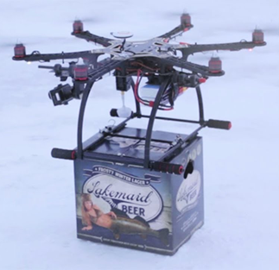
FAA Regulation Focuses on Use and User
Public
Commercial (Civil)
Private/Model
Photo credit: Lakemaid Beer

Slide 7
FAA's Four Categories for UAS

Slide 8
Part 107
First comprehensive UAS rules
Aimed at commercial operations
Public entities and recreational users can also use

Slide 9
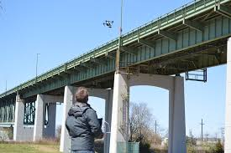
Part 107 Parameters
Parameters:
Less than 55lbs
Visual line of sight (VLOS)
Daylight hours or civil twilight with lighting
Below 100mph
Below 400 AGL or 400 feet of structure
Waivers available

Slide 10
Part 107 Pilot Requirements
Remote pilot in command:
Pass test for remote pilot certificate with small UAS rating
At least 16
No physical or mental condition

Slide 11
Events/Overflights
Observe restricted/prohibited flight areas
May be prohibited for major sporting events
Prohibited over people who are not “directly participating”
Except covered structure or stationary vehicle providing “reasonable protection”

Slide 12
Airport/Air Traffic Notification Requirements

Slide 13
FAA Airspace Classes

Slide 14
Video: Virginia Tech

Slide 15
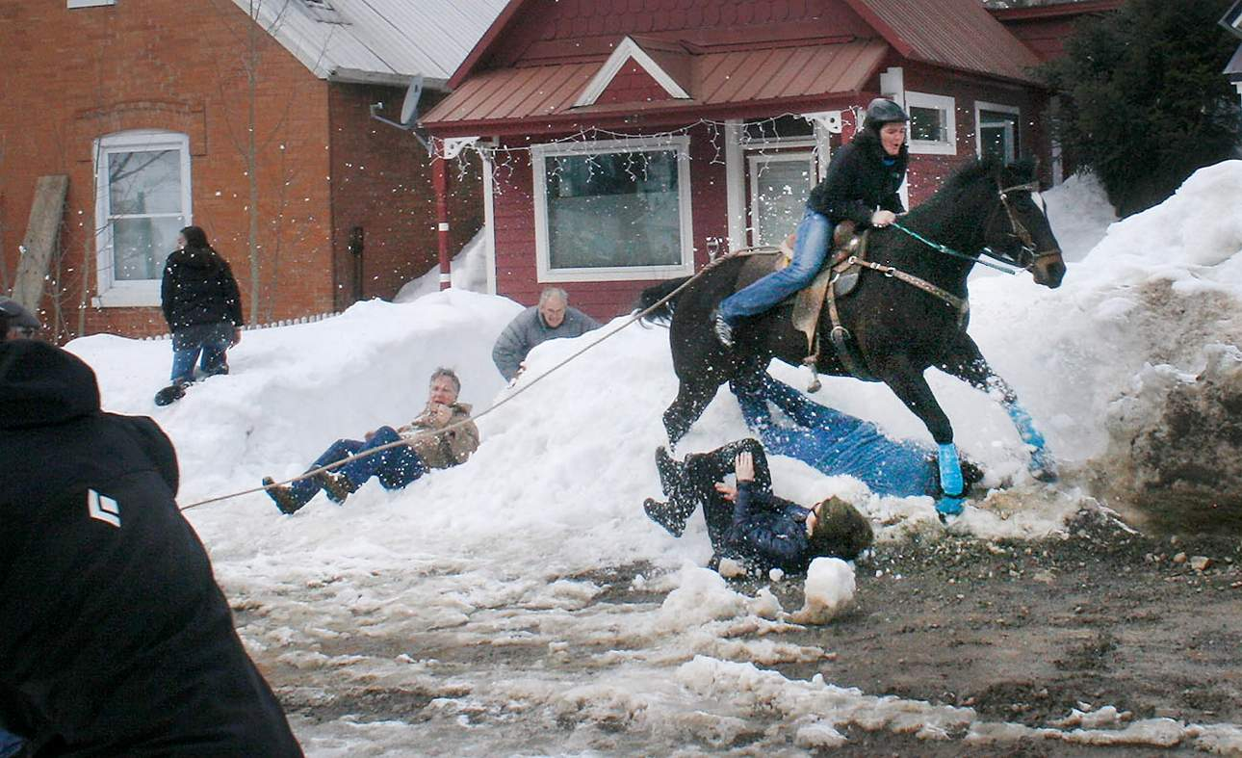
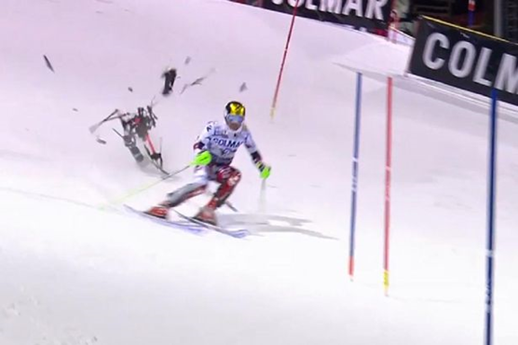
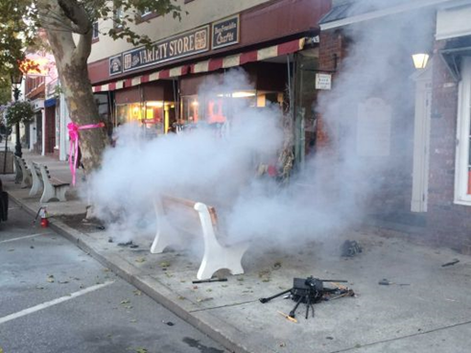
UAS Safety Concerns
Photo Credit: The Durango Herald

Slide 17
FAA Recreational Drone Regulations
Congressional exemption in 2012
FAA registration rule (Dec. 2015)
D.C. Circuit invalidated last month
Taylor v. Huerta
Future uncertain
General FAA rules?
Vacuum for local activity?

Slide 18
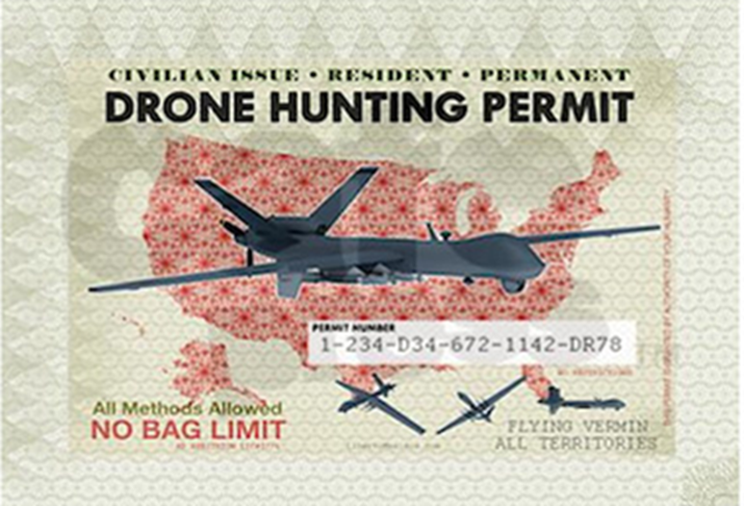
Local/State UAS Ordinances
Wide variety
Approx. 6 in Colorado
Limited experience with enforcement
Scope of preemption not tested
Generally-applicable laws untested

Slide 19
Possible Local Regulations --Types
Bans or moratoria
Safety
Use regulation (traffic, law enforcement, code enforcement)
Location regulation (airports, sensitive locations, parks, height)
Weaponizing
Interference with civic functions (firefighting, police, etc.)
Protection of privacy from government
Ban
Requirement for warrant
Limits on use
Data retention
Protection of privacy/property rights (private parties) from private parties
Height limits
Use of images
Trespass
Prior permission
Photo credit: http://increasinghumanpotential.org

Slide 20
FAA Position on Preemption
No express statement in Part 107
FAA Fact Sheet on State and Local Regulation of UAS (December 2015)
Some provisions preempted
State/local law may be appropriate for:
Privacy
Trespass/property rights
Intellectual property

Slide 21
Preemption Considerations
Pervasive federal control of aircraft and flight
See Banner Towing v. People of the City of Boulder (Colo. 1984)
Airspace
Potential airspace “gap”
See Causby v. U.S.

Slide 22
1000 feet (FAR floor: congested)
500 feet (FAR floor: uncongested)
Altitude
400 feet: Part 107 ceiling
200 feet (Pollack)
83 feet (Causby)

Slide 23
Preemption (continued)
Land use and protection from trespass not preempted
Non-aviation-specific provisions
Trespass
Careless/reckless behavior
Peeping Tom/Stalking
Interference with fire, police, etc.
Remote control use of weapons
Enforcement of federal standards?

Slide 24
On the Horizon
Drone Advisory Committee
Drone Federalism Act of 2017
FAA Reauthorization
Court Decisions

Slide 25
Heightened Preemption Risks
Regulation of flight differently than FAA
Restrictions on use in navigable airspace
Unlimited ceiling of prior permission
Restriction of federally-permitted operations
Regulation of aircraft
UAS-specific rule

Slide 26
Colorado Ordinance Examples
Vail
Prohibits UAS in critical areas
Cherry Hills Village
Recreational focus
Registration
Careless/reckless use
Over City/private property
Harassment
Telluride
Reckless/careless use
Harassment of wildlife
Trespass if no prior permission
Boulder County
Open Space

Slide 27
Law Enforcement
Local police/sheriff will be first line
FAA does not have resources or ability to respond quickly
Local law enforcement needs:
Clear rules
Training/education
Resources
FAA coordination
Challenges
ID of user
Uncertainty about authority

Slide 28
Risk Management Considerations for Municipal Ops
Own and operate or lease services?
Scope of insurance
Mutual aid agreement provisions
Internal policies regarding use
Safety
Data retention
Use of video/images
Training and compliance
4th Amendment considerations
Trespass

Slide 29
Questions?
John Putnam
Kaplan Kirsch & Rockwell LLP
Denver, CO
(303) 825-7000
jputnam@kaplankirsch.com
www.kaplankirsch.com

