Slide 1
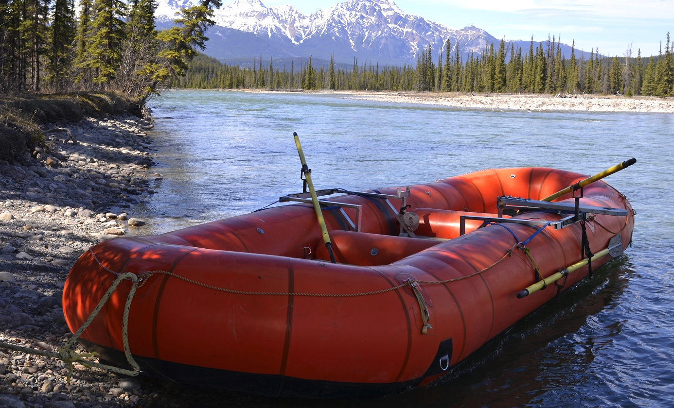
Building a Team with Your Council, Staff & Community
Building a Team with Your Council, Staff and Community

Slide 2
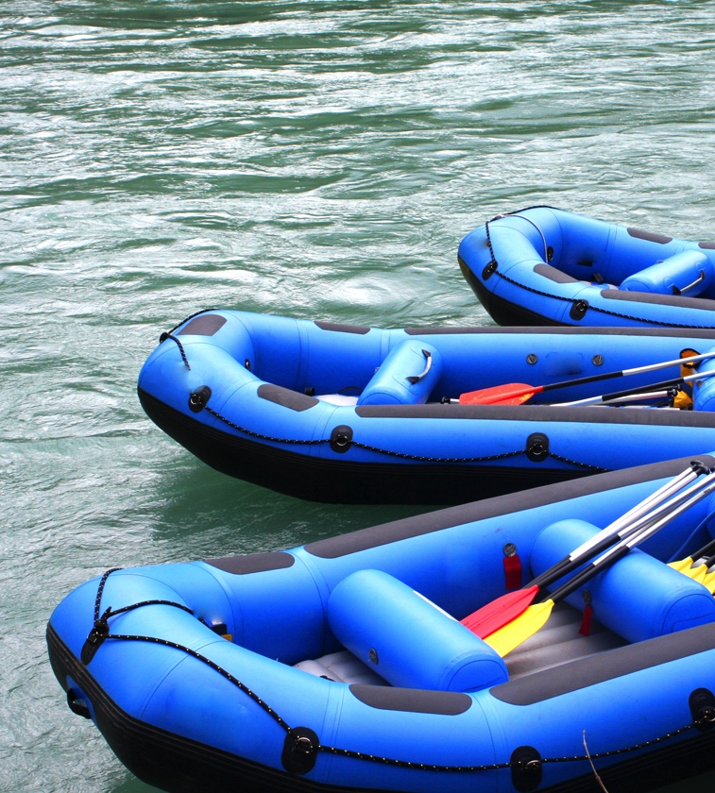
Talking Points
Prepare (Onboarding)
Communicate
Listen
Row in the same direction
Provide Constant Feedback
Notes:
Intro
Poudre River
In Fort Collins we have an amazing river that people love to raft.
When rafting a group/(we call it Council onboarding) a must work together
Prepare
Communicate
Listen
Row in the same direction
Provide Constant Feedback

Slide 3
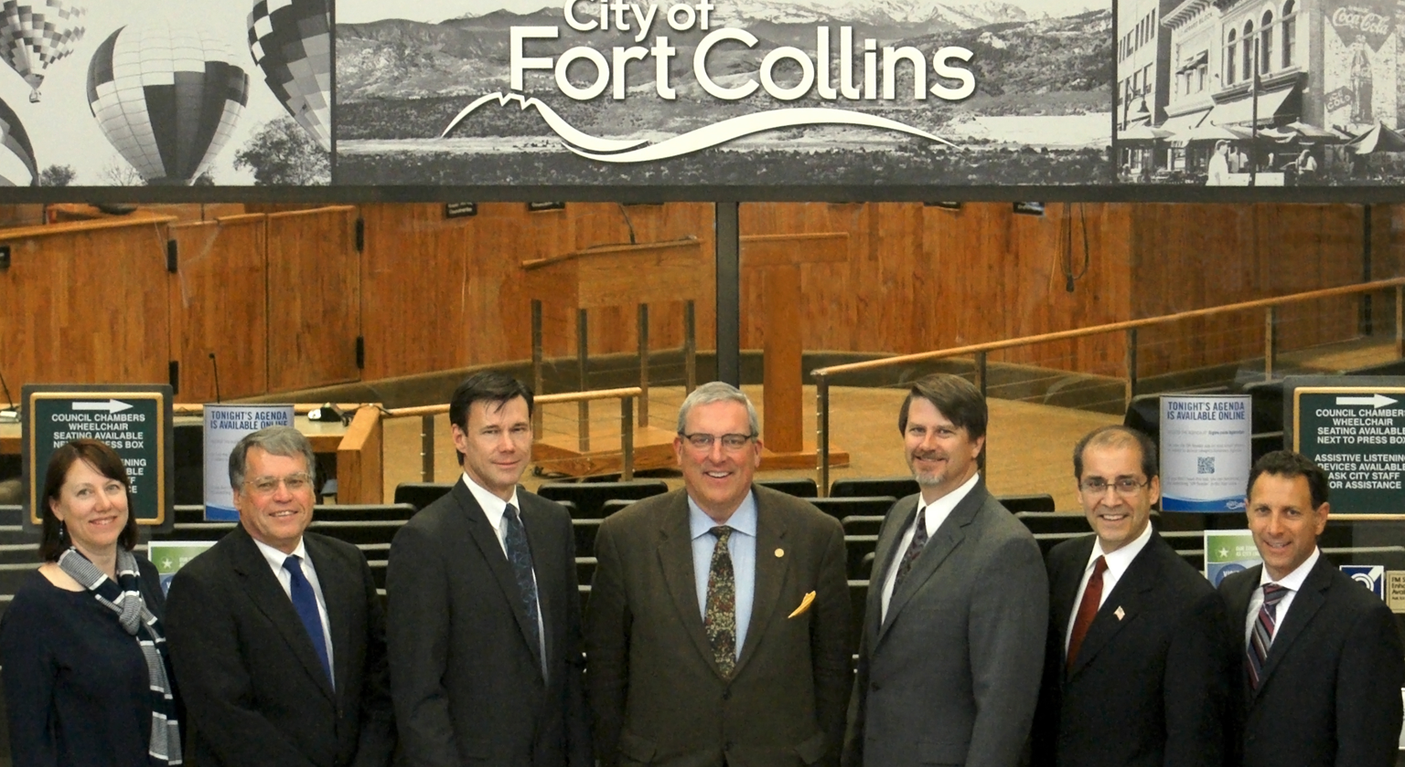
Prepare: Council Onboarding
Notes:
This rafting trip is much like Council & Staff’s journey with the City
Council
Seven passionate people come together with their own agenda and ideas (but they are all in the same raft and ultimately heading in the same direction)
Must work together to get things accomplished

Slide 4
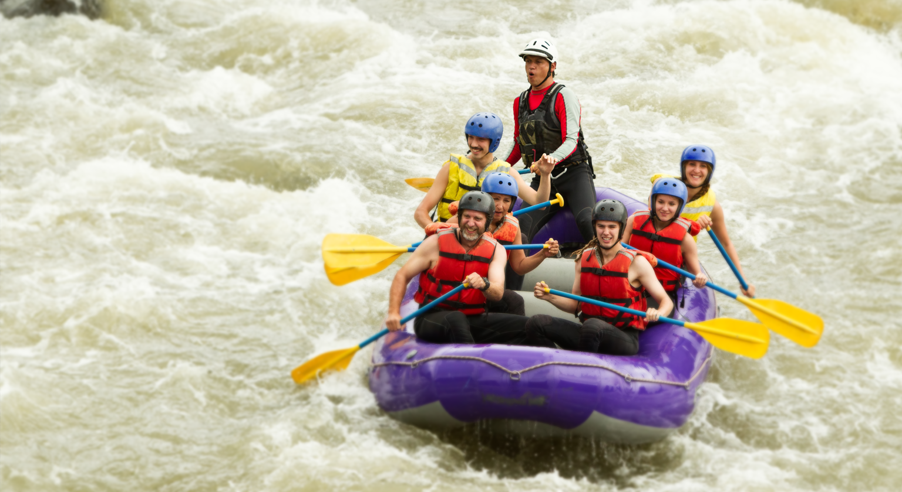
Communicate
Protocols
Processes
Staff Information
+
=
Notes:
Guide (tells when to row/provides guidance)
Onboarding Process
Helping council become familiar with:
Protocols- e.g.- Boards and Commissions liaison, Listening Sessions, etc.),
Processes- lots of information! (Tuesday and Thursday packet), SARs process, etc.
Staff information- staff experts provide information, data and recommendations

Slide 5
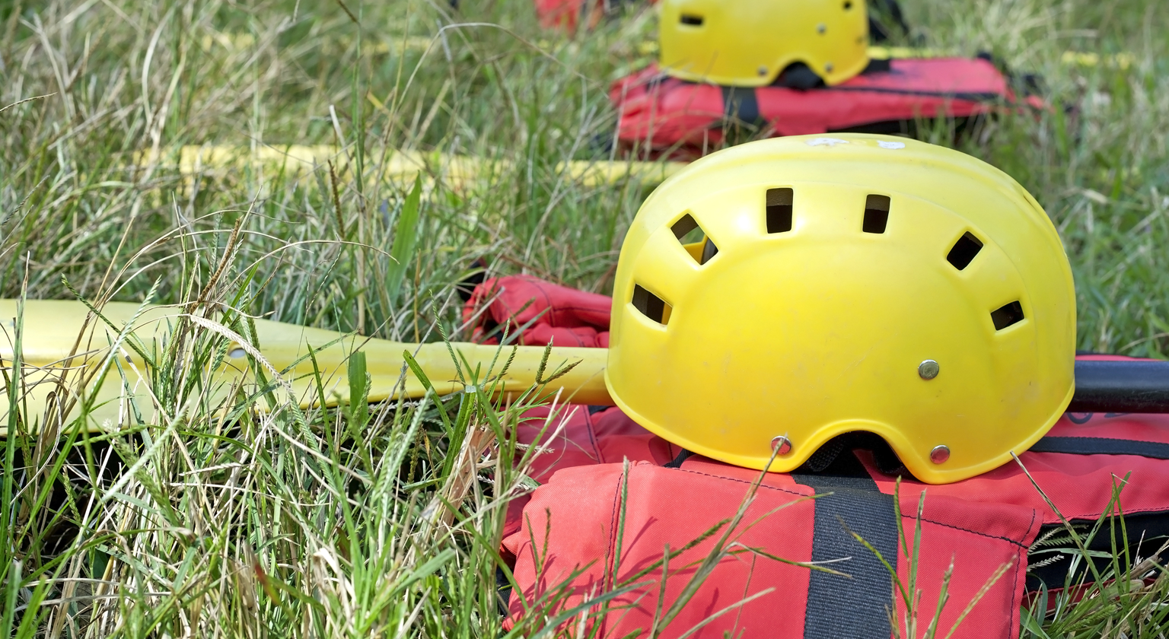
Listening
Notes:
Equipment (Gets you safely down river/Helps with tenure in office)
Helmet (protection)
Tools for safe conflict and respectful disagreement
Create a safe environment for honest exchange of ideas.
Life Vest (security)
Mission, Vision & Values
Goals & Key Initiatives
Paddle (Direction)
Strategic Plan & BFO Process/Key initiatives & enhancements
ELT/Boards & Commissions

Slide 6
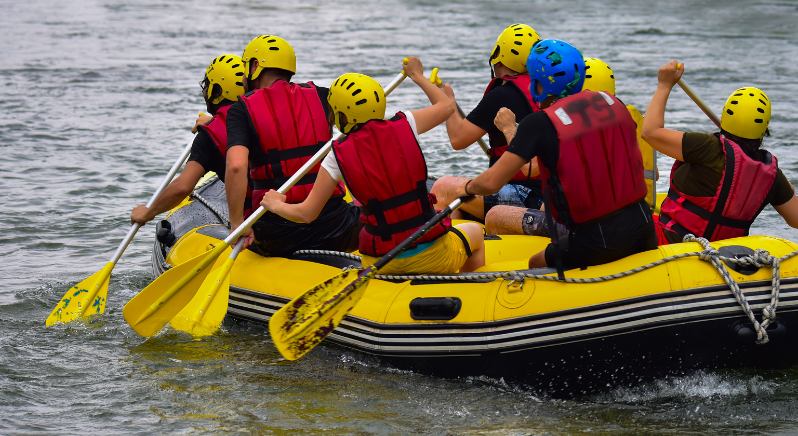
Row in the Same Direction
Notes:
Facilitator at Council retreat
All day, big picture
Opportunity for the Mayor and Council to discuss emerging priorities in the context of the City’s strategic plan, the current budget and the upcoming Budget process
Share thoughts on how each person contributes to the overall effectiveness of the governing body
Build relationships (for when the going gets tough)
Behaviors that build successful and a high performing council
Executive Team
Offers expertise, historical context, strategic priorities, and recommendations

Slide 7
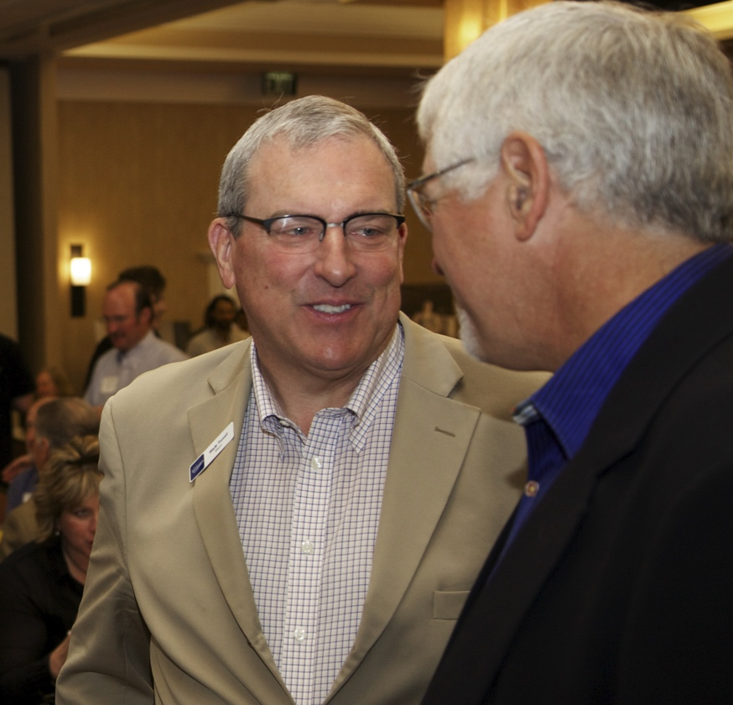
Provide Constant Feedback
Protocols
Processes
Staff Information
Notes:
Scout & Portage (Get out and read the terrain/Leave the office and talk with people)
Keeping public in the loop
Great feedback
Public very involved
Engagement reflective of community
Listening Sessions
Being proactive, not reactive Scout &

Slide 8
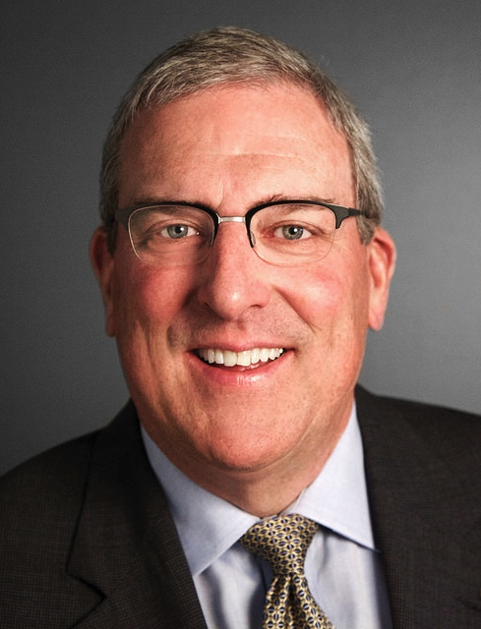
Closing
Mayor Wade Troxell
City of Fort Collins
(970) 219-2154
wtroxell@fcgov.com
@wadetroxell
Notes:
Closing Remarks
It takes a team effort
Everyone in the boat rowing the same direction
Hopefully have some fun along the way
Thank you

