Slide 1
CML’s 95th Annual Conference June 20 – 23, 2017 Breckenridge

Slide 2
The Value of Youth-Adult Partnerships Through Youth Commissions
Amina Youssef, Durango’s Mayor’s Youth Advisory Commission Co-Chair;
Brianna Brown, Durango Mayor’s Youth Advisory Commission Member;
Mary Beth Miles, Staff Liaison for the Mayor’s Youth Advisory Commission

Slide 3
How many of you have a Youth Commission in your community?

Slide 4
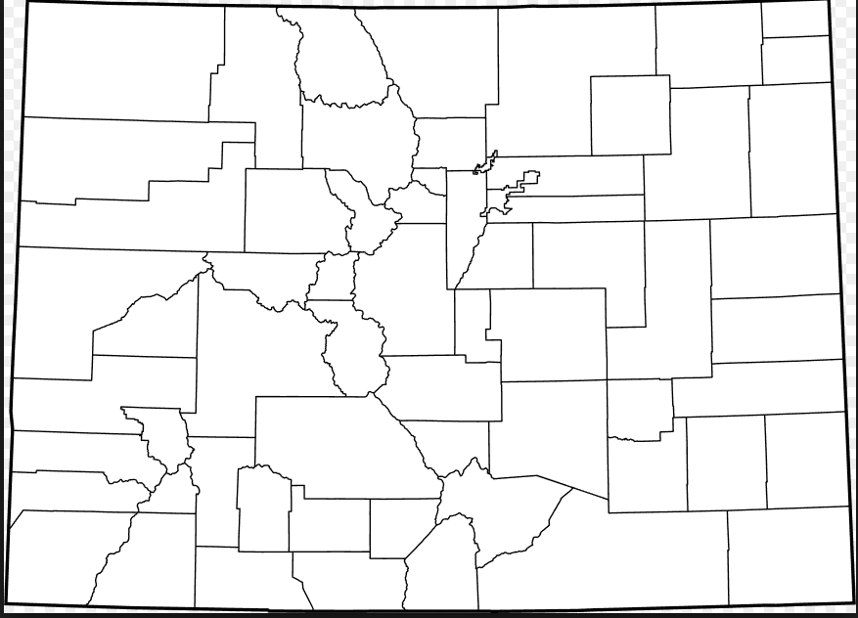
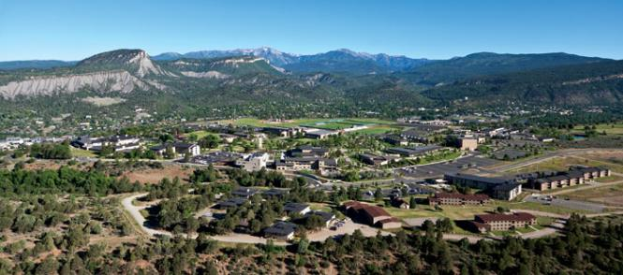
DEMOGRAPHICS
Population:
17,818
Durango, CO
Annual Operating Budget: $81 M
Notes:
Population: 17,818 SDO 2014
Home to FLC & DNGRR

Slide 5
Mission Statement
“The City of Durango’s Youth Engagement Program aims to promote youth and community partnerships, encourage teen engagement and cultivate meaningful opportunities for Durango’s young adults.”

Slide 6
Shared Leadership
Influence
Service
Youth Contribute to the Community
Community Contributes to Youth
“There must be an unwavering belief that youth engagement in government is good for government.”
-Building Effective Youth Councils

Slide 7
Why Are We Involved?
Participate in planning and decision-making processes
Learn how municipal government works
Avenue for youth to express opinions
Engage in the community
Be informed
Develop mentor relationships
Opportunity to make a difference
Build skills, experience, and confidence

Slide 8
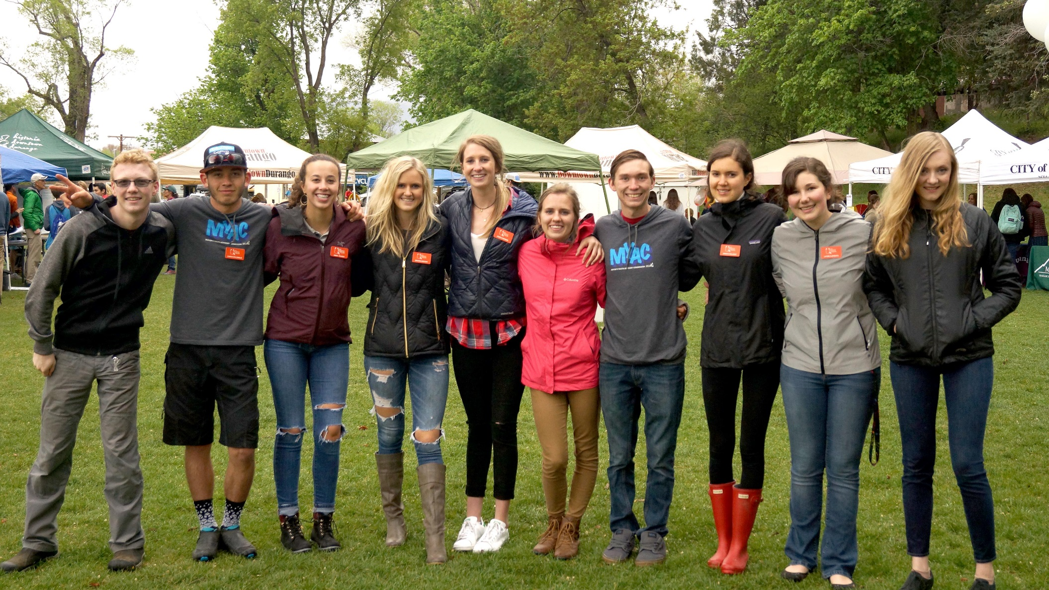
Who Are We
Comprised of Durango Youth in grades 9th through 12th
Youth are appointed by City Council and serve one-year terms
Meet twice per month August - May

Slide 9
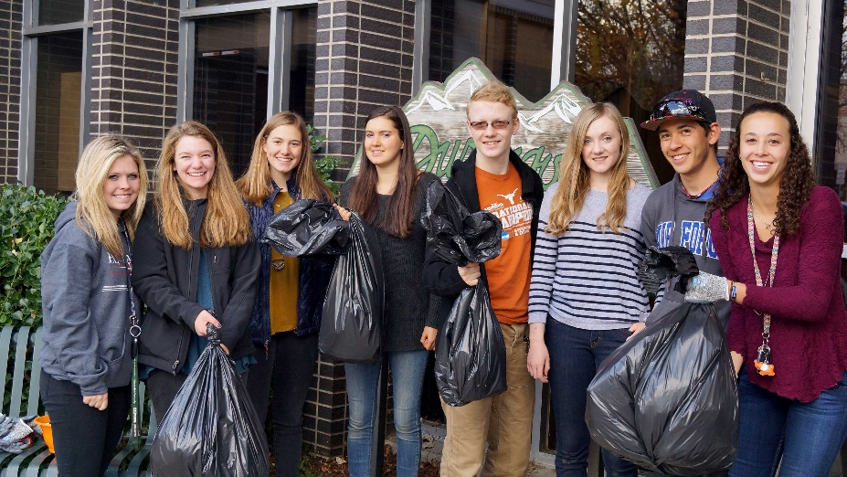
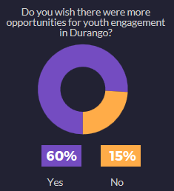
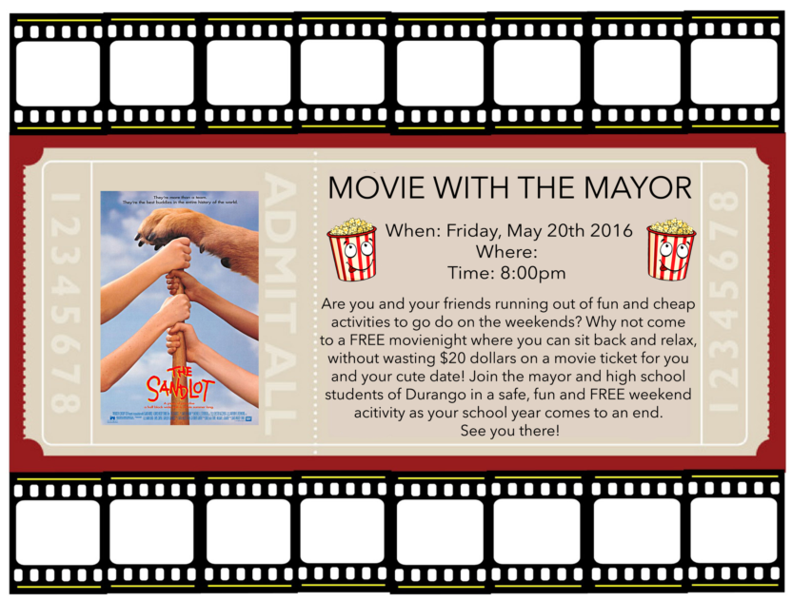
How Do We Engage Youth…
Community Service: Hallow-Clean
Youth Surveys
Special Events: Movie with the Mayor
Social Media
Notes:
Youth Survey
National League of Cities Conference
Annual Youth Expo (5 years)
Middle School Outreach
Code of Conduct
Snowdown Events
What I’m Thankful for in
my Community Wall
2015 Youth Survey
Movie with the Mayor
Youth Art Expo (DPL)
Address Issues that are important to youth & the Community (i.e. suicide awareness)
Community Service
Social Media

Slide 11
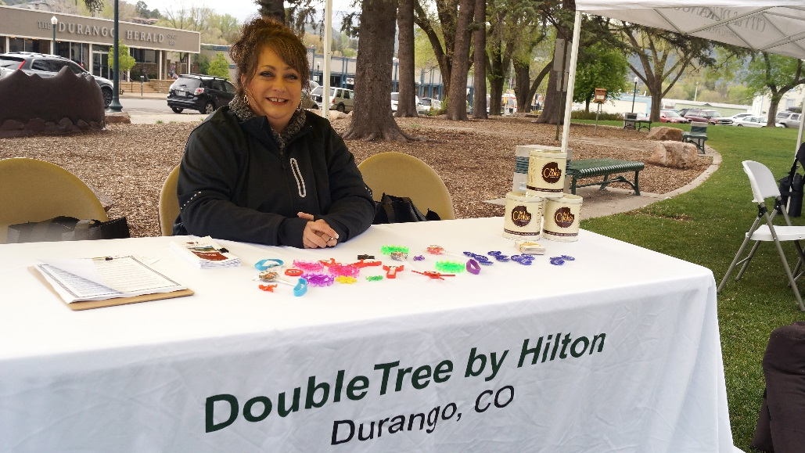
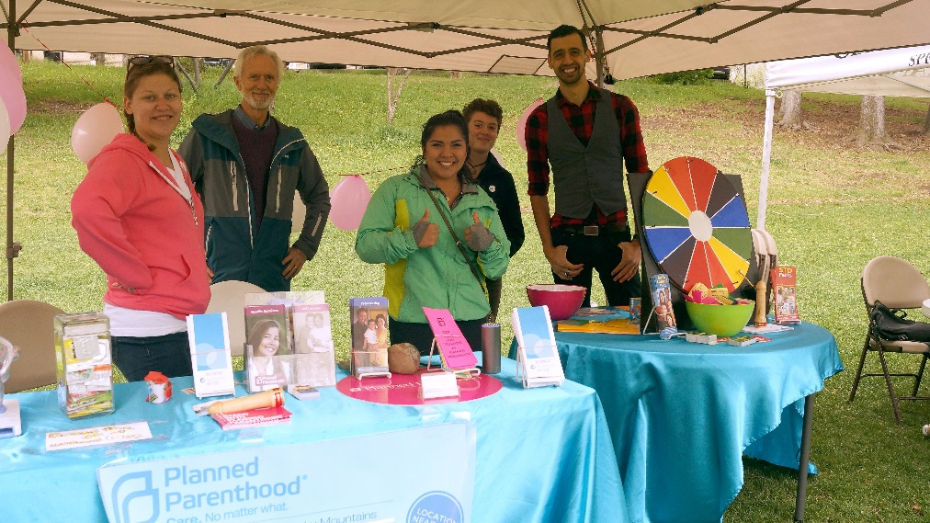
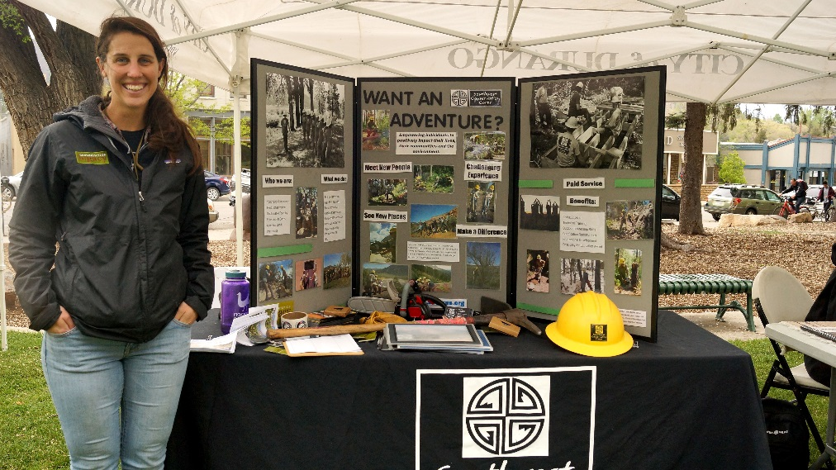
25+ Vendors

Slide 12
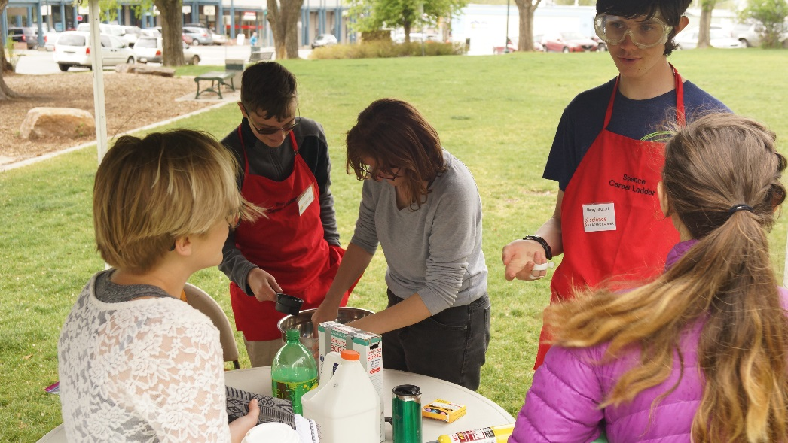
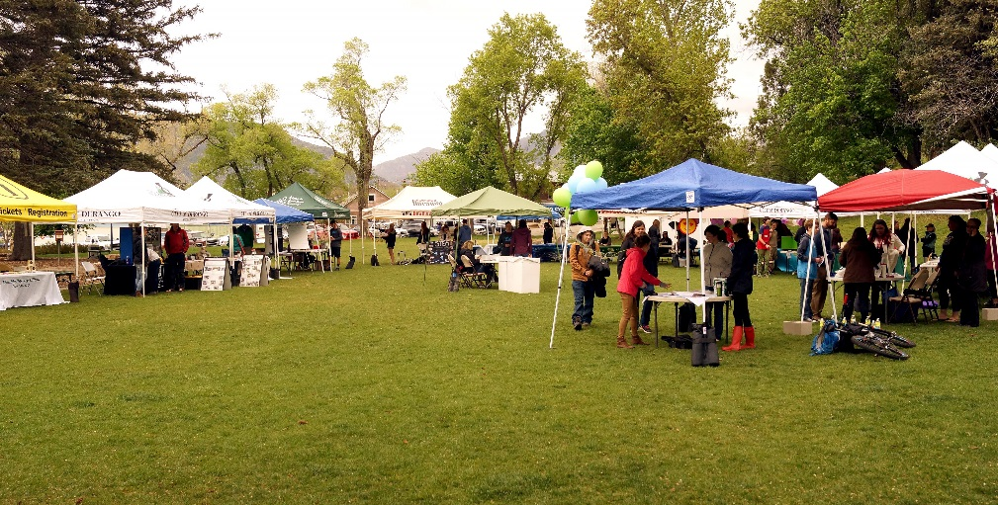
40+ Students

Slide 13
Snowdown Events

Slide 14
Advise City Council on Policies Issues
Transportation Funding
E-bikes
Participate in Wastewater Treatment Plant Design Process
Provide Feedback to Other Boards (e.g. Business Improvement District and Library Advisory Board)

Slide 15
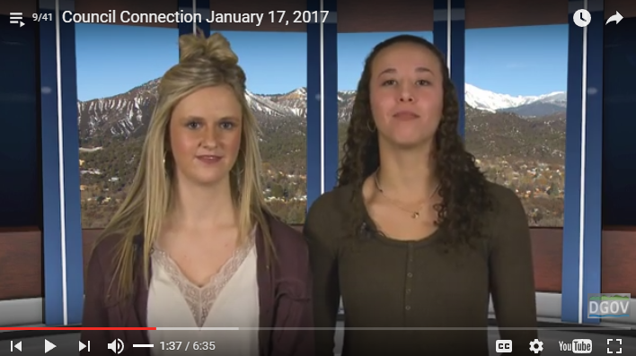
Outreach

Slide 16
Opportunities for the Future
Suicide Awareness
Community Service
Engage More Youth

Slide 17
Program Structure & Logistics
Youth Engagement Program
Mayor’s Youth Advisory Commission
Youth Liaisons for Boards and Commissions
Meeting Frequency & Types
Roberts Rules of Order
Program Support
Mayor
Staff
FY 2017 Program Budget: $2,250
Recruiting Process

Slide 18
Questions?
www.durangogov.org

